Slide 1
Consumer Climate 2014 – opportunities and risks of digitization
Matthias Hartmann, CEO GfK SE
Vienna, Hofburg | January 29, 2014

Slide 2
Agenda
Global economy 2014 – how does the consumer climate develop?
How consumer behaviour is shifting
Digitalization – Transformation of business models via Big Data
Data, data, data – The effects of recent data scandals
from a consumer perspective

Slide 3

GfK - ‘Growth from Knowledge’
GfK makes research matter by delivering the future.
In a digitized world, we are the trusted source of relevant market and consumer information that empowers our clients
to make smarter decisions.
As thought leaders in our industry, we have a deep understanding of consumer experiences and choices.
We are 13,000 passionate experts with more than 80 years
of data science experience and German heritage.
We deliver globally with vital insights into local markets
in 100 countries.
We turn research into business opportunities. Through innovative systems and partnerships, we integrate on- and
off-line data to support Growth from Knowledge.
Our goal is simple: enable our clients to create winning strategies to enrich consumers’ lives.

Slide 4
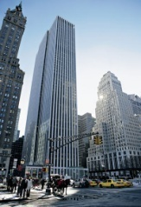

GfK Group: a strong heritage in market research
1. Business overview
1.2 GfK at a glance
1934
Founded as
GfK-Nürnberg e.V.
(the GfK Verein)
1970
Start of retail panel research
Clients from food, photo and automotive industry
1990
Legal change to unlisted stock corporation
Focus on internationalization
2005
Acquisition of
NOP World
Major step towards global business
2012
Own the Future
New strategy for global integration of GfK
1957
Start of panel
research with 1.000 German households
First contract with Henkel
1984
Operations hived off into a limited liability company;
GfK Association to retain status as a non-profit organization
First contract for TV audience measurement
1999
GfK shares start
trading on the
Frankfurt stock
exchange
Globally active pure market research player
2009
Change to
a European
joint stock company
Societas Europaea (SE)
Represents international
corporate culture

Slide 5

GfK Group: a strong heritage in market research
1. Business overview
1.2 GfK at a glance
1934
Founded as
GfK-Nürnberg e.V.
(the GfK Verein)
1970
Start of retail panel research
Clients from food, photo and automotive industry
1990
Legal change to unlisted stock corporation
Focus on internationalization
2005
Acquisition of
NOP World
Major step towards global business
2012
Own the Future
New strategy for global integration of GfK
1950
Dr. Fessel and
Dr. Geppert found “Berechnungsbüro für Wirtschaft und Industrie“
1957
Start of panel
research with 1.000 German households
First contract with Henkel
1972
Cooperation with GfK
2009
Change to
a European
joint stock company
Societas Europaea (SE)
Represents international
corporate culture
1984
Operations hived off into a limited liability company;
GfK Association to retain status as a non-profit organization
First contract for TV audience measurement
1999
GfK shares start
trading on the
Frankfurt stock
exchange
Globally active pure market research player

Slide 6
Global economy – Confirmed recovery
Change in gross domestic product vs. previous year [in %]
Global Economy
Euro Zone
UK
USA
2013
2014
2013
2014
2013
2014
2013
2014
Russia
Japan
China
India
2013
2014
2013
2014
2013
2014
2013
2014
Source: DIW (as of: 18.12.2013)

Slide 7
Economical situation in Western-Europe
Change in gross domestic product vs. previous year [in %]
2013
2014
2012
2013
+1,3
-1,0
+1,7
0,3
+0,4
+1,6
+0,2
+0,4*
+0,6
+1,7*
-1,8
+0,6
-1,5*
0,6*
-1,2
+1,0
-4,2*
-1,0*
Source: DIW (as of: 18.12.2013) , * P, A, GR: Projektgruppe Gemeinschaftsdiagnose (17.10.2013)

Slide 8
Income prospects in Europe still mostly clouded, but in all countries (mostly) above previous year
Income expectation
Average 2. half-year 2013
-4
-31
+39
-43
+8
Euro zone
-20
-18
(2012: -52)
-34
-15
-43
Source: GfK, EU-Commission

Slide 9
Germans are still the consumer optimistic of Europe, followed by Austrians
Willingness to buy
Average 2. half-year 2013
-24
-23
+44
-33
+6
-22
-40
-16
Euro zone
-14
-29
Source: GfK, EU-Commission

Slide 10
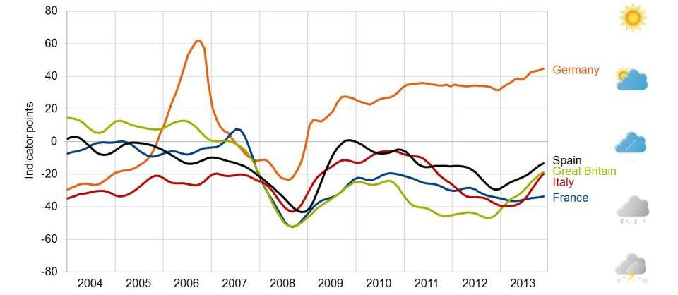
... but also clear upward tendency in Europe
Willingness to buy
Source: GfK, EU-Commission

Slide 11
Accordingly, 2014 growth improvement for private consumption is expected in all countries
Private consumption, real [change compared to last year in %]
in %
2013
2014
1,7
1,8
-2,1
-1,6
1,1
1,8
0,5
0,9
-0,2
-0,6
0,5
+107
-2,3
-0,4
-2,6
0,8
0,0
-2,6
-6,4
Source: OECD Economic Outlook 94 database (Stand: 24.01.2014)

Slide 12
Digitization and big data
Data Federation
RESISTANCE
ANONYMISATION
PASSIVE MEASUREMENT
Brick & Click
PRIVACY
CURRENCY
BIG DATA
COMMODITIZATION
Analytics
CULTURAL CHANGE
OFFLINE & OFFLINE
SELF-CANNIBILIZATION
Trust
DIGITAL TRACES
SPEED
NEUTRAL
HYBRID MODEL

Slide 13
The digital opportunities are changing the consumer behaviour
Purchase behaviour in % of expenditure for non-food consumer goods
Information search
Online
Offline
Online becoming more important as well in information search as purchase
Online
14,4%
16,2%
12,1%
1,1%
1,3%
1,5%
2010
2011
2012
2010
2011
2012
Purchase
78,9%
76,4%
The exclusive offline purchase process is less and less important
73,8%
Offline
7,9%
7,9%
8,5%
2010
2011
2012
2010
2011
2012
GfK Consumer Panel Non-Food/ROPOs

Slide 14
Top 10 – Mistrust* in institutions/Businesses regarding treatment of your personal data
in %
*Rather don‘t trust them/ Don‘t trust them at all I Source: GfK Verein, Studie „Daten & Schutz“, November 2013 I Basis: total sample, n=2014
Notes:
Speaker notes

Slide 15
Non-users because of data security
in %
Source: GfK Verein, Studie „Daten & Schutz“, November 2013 I Multiple answers possible I Basis: Internet users, n= 1547
Notes:
Speaker notes

Slide 16
Privacy
Espionage
Privacy
Convenience
Misuse of data
Functionality
…
Incentives
…
This balance is shifting over time
Generational differences, predicting where future could go
Trade off between convenience and privacy resulting in new business models
Shift of power increases need of protection and opens opportunity for neutral parties

Slide 17

GfK Austria
Ungargasse 37
1030 Vienna
+43 1 717100
at@gfk.com
www.gfk.com/at

