Slide 2
What is the Scorecard?
A comprehensive, systematic annual assessment of Europe’s performance in achieving its goals in the world
A team of 40 researchers advised by a Steering Group
Europe = EU + the 28 member states
Europe is assessed on 6 issues divided into 66 components
Grades (A-D) are awarded on the basis of unity, resources and outcome
Member states are categorised as “leaders”, “supporters” or “slackers”

Slide 3
2013: Two historic successes, a long time in the making
Iran breakthrough:
European response to President Bush’s “axis of evil” speech (2002)
E3+3 talks began in 2007
Serbia-Kosovo deal:
European attempt to stabilise the Balkans since the NATO military intervention in Kosovo (1999)
Steps towards normalisation between Serbia and Kosovo since 2004

Slide 4
Factors of success?
excellent collaboration between the EU and the member states most involved.
role of High Representative Catherine Ashton
showed European toughness and persistence
popular desire to move on and improve economic conditions

Slide 5
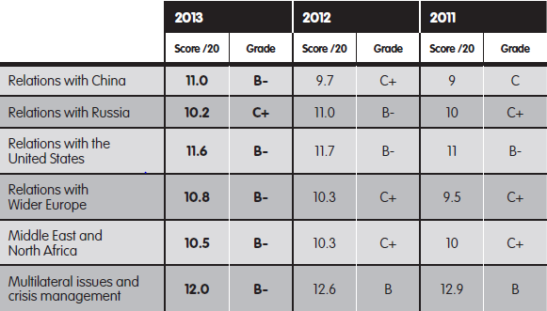
Overall scores

Slide 6
Key findings (1)
China (B-) – Europe and China co-operated on Syria, Mali and the Iranian nuclear problem, but member states undermined the European Commission in the solar panel dispute with China.
Russia (C+) – Europeans struggled to respond to increasing pressure on eastern neighbourhood states. European resolve on energy issues did not lead to successful diversification of energy.

Slide 7
Key findings (2)
United States (B-) – There were breakthroughs on TTIP negotiations and co-operation on an Iran nuclear deal. But the Snowden revelations led to a breakdown in European trust in the US.
Wider Europe (C+) – Ashton facilitated a historic agreement between Kosovo and Serbia. But setbacks in negotiations with Ukraine and Armenia showed that Europe needs to find a way to respond to Russian pressure.

Slide 8
Key findings (3)
Middle East and North Africa (C+) – A breakthrough with Iran, but elsewhere Europe struggled as the conflict in Syria worsened and the military took over in Egypt.
Multilateral issues and crisis management (B) – France intervened in Mali and CAR but only got limited support from other member states. Diplomatic efforts on Syria and climate issues were disappointing

Slide 9
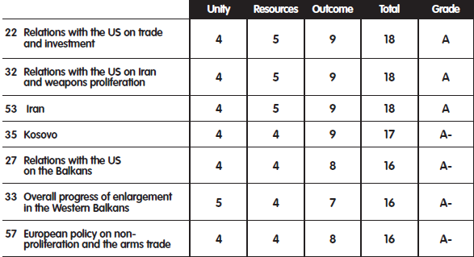
Europe’s best policies

Slide 10
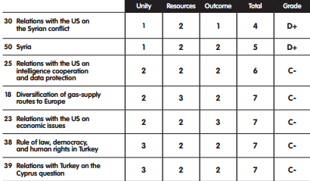
Europe’s worst policies

Slide 11
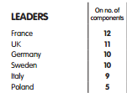
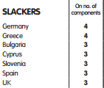
Top “leaders” and “slackers”

Slide 12
The Big 3
France becoming more “British”?
UK becoming more “German”?
Germany becoming more “Polish”?

Slide 13
2 Transatlantic stories
TTIP could be the EU’s next big success story
But Transatlantic unity undermined by Snowden revelations of NSA spying
Transatlantic split could be more damaging than the Iraq war a decade ago
Did not derail TTIP negotiations in 2013 but could in 2014

Slide 14
Thank you!

