Slide 2
The Age of Planetary Boundaries
3 billion more middle class consumers expected to be in the global economy by 2030
80% rise in steel demand by 2030
Since the turn of the century, 147% increase in real commodity prices
December 2010, FAO food price index at all time high (2010 to 2011 wheat prices rose by 75%)
100% increase in the average cost to bring a new oil well into production in last two decades

Slide 3
Outlook for world energy demand
Billion tonnes of oil equivalent
18
Other renewables
16
Biomass
14
Hydro
12
Nuclear
10
Gas
8
6
Coal
4
2
Oil
0
1980
1990
2000
2010
2020
2030
Without major policy change, we will face three major challenges:
energy security, energy access and climate change
Source: IEA
Notes:
3

Slide 4
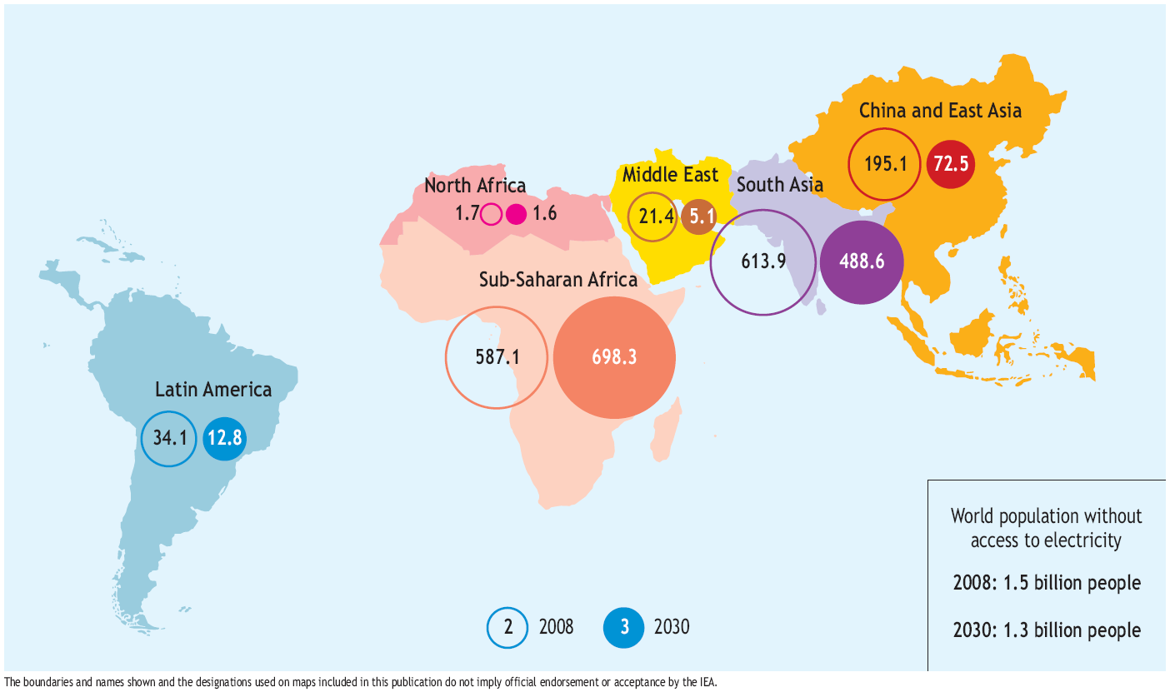
Energy Poverty
Source: IEA, 2009
Under BAU, 1.3 billion people – or 16% of the world’s population – still lack access to electricity in 2030, despite more widespread prosperity & more advanced technology

Slide 5
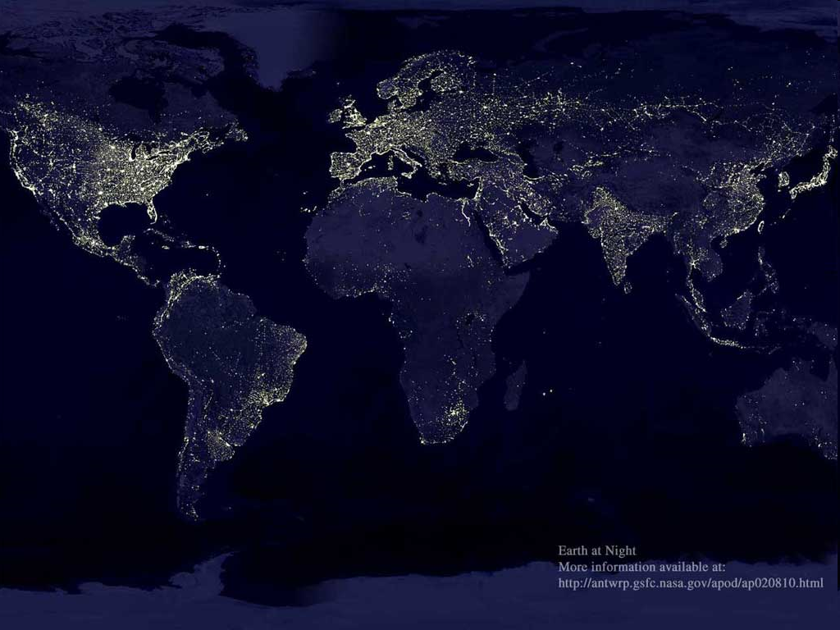

Slide 6
The UN Secretary-General, Ban Ki-moon, has established a new
High-Level Group on Sustainable Energy for All
Co-chairs: Yumkella and Holliday (Bank of America)
Multi-stakeholder group with strong private sector participation
Full Action Agenda delivered at Rio+20, 2012

Slide 7
By 2030:
Universal Access
Double the historical rate of improvement in Energy Efficiency
Double the share of Renewable Energy in the overall mix

Slide 8
Implications of achieving universal modern energy access
20
0.7%
40
Additional energy demand in the
Energy for All Case
1.1%
Gigatonnes
15
30
World energy demand in the
central scenario
Billion tonnes of oil equivalent
10
20
Additional CO₂ emissions in the
Energy for All Case (right axis)
5
10
World CO₂ emissions in the
central scenario (right axis)
0
0
World energy
demand
2030
World CO₂
emissions
2030
Universal modern energy access does not have any significant
impact on energy or climate security
Source: IEA
Notes:
8

Slide 9
Achieving SE4ALL
Increase energy access
Universal access is achievable by 2030 – financing is key
To support a move to a CO₂ path consistent with 2ºC
More than double the use of modern renewables by 2030
Reduce energy intensity by 40% by 2030
Rio+20 is a unique opportunity to set goals that help the world achieve …a better energy future
Source: IEA
Notes:
9

Slide 10
Key role of natural gas
Low-carbon transitional fuel towards clean, sustainable energy
Key for expanding clean energy access around the world
- in combination with coal
- facilitating the growth of renewable energy
- replacing polluting fuels in transportation and buildings.

Slide 11
Clean cooking solutions
Need USD 74-100 Billion by 2030
Need USD 20 Billion for LPG
- to reach 220 million households
- to reduce 2 million premature deaths per year
- to save 20 hours per week labour for women and children
Role of gas

Slide 13
Movement for the Emancipation of the Niger Delta

Slide 15
